Slide 1

HMIS End User Workgroup
Cleveland/Cuyahoga County Office of Homeless Services
1/17/2025

Slide 2


Housekeeping
This workgroup will be recorded and made available on OHS’s website by early next week.
Please stay muted.
If you have a question:
“Raise your hand” function
Put it in the chat
Information shared in this workgroup should be disseminated to all HMIS end users regardless of their attendance today.

Slide 3

Agenda
Housing Inventory Count (HIC)
Point-In-Time (PIT) Count
Live Q&A

Slide 4

Housing Inventory Count (HIC)

Slide 5


Definition & Applicable Projects
A point-in-time inventory for all projects within the Cuyahoga CoC that provide beds/units to persons who are or were homeless upon entry.
Applicable project types:
  Emergency Shelter – Entry/Exit
  Transitional Housing
  Safe Haven
  Permanent Supportive Housing
  Other Permanent Housing (EHVs)
  Rapid Rehousing
BED = persons
UNIT = households, apartments, etc.

Slide 6

Data Required
Total number of year-round beds with subsets identified for:
  Households with children
  Households without children (includes households with only adult children or multiple adults)
  Households with only children
  Veteran beds (with, without, and with only children)
  Youth beds (with, without, and with only children)
  Chronically Homeless beds (with, without, and with only children)
Total number of seasonal beds
Total number of overflow beds
Point-in-time count of persons served on PIT night (1/28/25)

Slide 7
Data Collection Processes
HMIS-Participating Projects
Non-HMIS-Participating Projects
ES, TH, SH, & PSH (project-based)
  Bed/unit inventories should be reported to OHS via email by 1/24/2025.
    Should include only those beds/units that are ONLINE on the night of the PIT count
RRH & PSH (tenant-based)
  Bed/unit inventories should be reported to OHS via email by 2/18/2025.
    Should include only those who have a move-in date entered
OHS will compare reported numbers to what is present in HMIS and update inventories, as needed.
Utilization issues: if utilization is above 105% or low (determined by project type), expect an email from OHS for explanation
Review your bed/unit inventory for each applicable project
  Should include only those beds/units that are ONLINE on the night of the PIT count
Send an email to OHS confirming your bed/unit inventory by 1/24/2025 using the breakdown provided in previous slide
Census will need to be provided via another email by 2/18/2025.
Utilization issues: if utilization is above 105% or low (determined by project type), expect an email from OHS for explanation

Slide 8

Point-In-Time (PIT) Count

Slide 9

Definition & Applicable Projects
A one-night count of all persons experiencing both sheltered and unsheltered homelessness in the CoC.
This year’s PIT date = 1/28/25
Why conduct the count in January?
  HUD believes that this count is more precise when determining who is unable or unwilling to access traditional shelter, helps raise public awareness, and a tool to adjust interventions.
Applicable project types:
  Emergency Shelter – Entry/Exit
  Transitional Housing
  Safe Haven
  Unsheltered

Slide 10
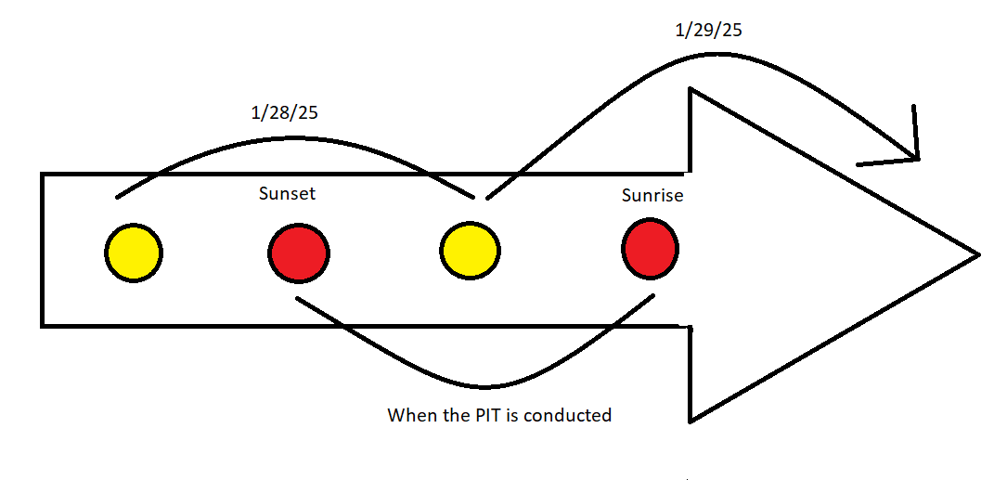
Timing of the Count
1/28/25 is the night of the count.
The term “night” refers to a period of sunset to sunrise spanning two dates (1/28/25 and 1/29/25).
Locally, we have set the timing of the count starting at 5:30p on 1/28 and ending at 10a on 1/29.

Slide 11
Data Required
HOUSEHOLD TYPES:
DATA REQUIRED FOR EACH HOUSEHOLD TYPE:
SPECIAL SUBPOPULATIONS
Households with children
Households without children
Households with only children
Youth Households without children
Youth Households with children
Veteran Households with children
Veteran Households without children
# of households served
# of persons served in those households with the following subsets identified:
  Age tiers (under 18, 18-24, 25-34, 35-44, 45-54, 55-64, 65+)
  Gender
  Race & Ethnicity
  Chronic homelessness status
# of adults (all populations; older than 18) with/who are:
  Serious Mental Illness
  Substance Use Disorder
  HIV/AIDS
  Survivors of Domestic Violence

Slide 12
Data Collection Processes
Sheltered Count – HMIS
Sheltered Count – Non-HMIS
After the PIT date, ensure that all entries and exits are completed in HMIS.
  ONLY CLIENTS WHO STAYED THE NIGHT ON THE PIT NIGHT SHOULD BE OPEN!
Run an APR (HUDX-227) for the PIT date and ensure all errors are fixed.
  Specifically, ensure the correct people are showing as active and that all disability/DV questions are answered.
Send an email to OHS with APR attached confirming the numbers are correct by 2/18/2025.
After the PIT date, ensure that all data collected in an HMIS-comparable database is accurate.
Pull a roster report for the PIT date with all the required data elements listed in previous slide – this should include NAMES, DOBs, and SSNs (if acquired) of all program participants.
Send roster as a spreadsheet to OHS by 2/18/2025.

Slide 13
Data Collection Processes
Unsheltered Count
Prior to the PIT date, OHS & NEOCH will convene a meeting with outreach providers and other volunteer groups to discuss deployment plan.
During the week of 1/20/2025, those providers are to pick up a set of PIT Street Cards from OHS’s office
  310 W Lakeside, Cleveland, OH 44113
Starting at 5:30p on 1/28/25 and ending at 10a on 1/29/25, the count will be conducted, focusing on those who are bedded down for that night.
Each person interviewed should have PIT Street Card filled out in its entirety. Cards with missing identifying information will be left out.
PIT Street Cards are to be returned to OHS’s office before 1/31/2025.
Any card turned in after that date will not be considered.

Slide 14
Data Collection Processes
Deduplication Process
OHS will review and compare all PIT Street Cards, rosters from non-HMIS-participating providers, and rosters from HMIS-participating providers.
Any PIT Street Card that is incomplete/does not have enough identifying information on it will be discarded.
Any PIT Street Card that is duplicated with a sheltered situation will be discarded.
Any duplicated, sheltered person will be discussed by OHS and the providers that are overlapping until only one shelter enrollment exists.

Slide 15

IMPORTANT NOTE
The hmis data submitted for both the HIC and PIT Count should NEVER be changed over the course of the year!
All end-of-year, federal reporting is going to refer to what was submitted for this count and the data will need to match!
By confirming your data via email to OHS, you are agreeing that this data will never change and is completely accurate!

Slide 16

Links to Resources
2024 Housing Inventory Count (HIC) and Point-In-Time (PIT) Count Data Collection Notice
  https://www.hud.gov/sites/dfiles/CPD/documents/2024-HIC-and-PIT-Data-Collection-Notice-2023-11-02.pdf
HUD Point-In-Time (PIT) Count Methodology
  https://files.hudexchange.info/resources/documents/PIT-Count-Methodology-Guide.pdf
Cuyahoga County CoC 2025 Point-In-Time Count and Housing Inventory Count Guidance Document
  file:///H:/PIT%20HIC/2025/Cuyahoga%20Continuum%20of%20Care%202025%20PIT%20HIC%20Guidance.pdf

Slide 17

QUESTIONS

