Slide 1

HMIS End User Workgroup
Cleveland/Cuyahoga County Office of Homeless Services
9/20/2023

Slide 2


Housekeeping
This workgroup will be recorded and made available on OHS’s website by early next week.
Please stay muted.
If you have a question:
“Raise your hand” function
Put it in the chat
Come off mute and ask directly
Information shared in this workgroup should be disseminated to all HMIS end users regardless of their attendance today.

Slide 3

Agenda
2024 Data Standards Release Timeline
Screen Updates
Updates impacting multiple screens
Profile
Enrollment
Status and Current Living Situation
Services & Events
Exit
Live Q&A
Program Setup

Slide 4

2024 Data Standard Release Timeline
September 1st
September 18th
October 1st
All updates to the data standards were made available in our Clarity Training Site
All updates to the data standards were made available in our Clarity Live Site
All screens and updated fields are marked “Do Not Use” until live release on 10/1/2023
2024 Data Standards go live!
Any data collected will need to reflect the changes outlined today.
All screens and templates (except Custom screens) will be updated automatically by Bitfocus.
Reporting will be switched to new fiscal year requirements – EXCEPTION: HUD CSV/XML EXPORT & ESG CAPER (both versions available)

Slide 5


Updates on Multiple Screens
All fields: “Client refused” updated to “Client prefers not to answer”
This will be the recommended answer for all missing data

Slide 6
Updates on Multiple Screens
VA Health Insurance
  “Veteran’s Administration (VA) Medical Services” updated to “Veteran’s Health Administration (VHA)”
Survivors of Domestic Violence
  Wherever mentioned, phrasing updated to “Survivors of Domestic Violence”
HOPWA Screens: Medical Assistance
  “Receiving Public HIV/AIDS Medical Assistance” removed

Slide 7

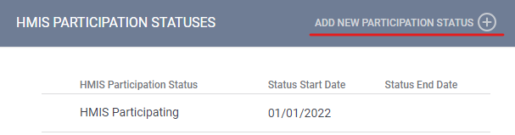
Program Setup Updates
HMIS Participation Status
  This has been always been tracked. Now includes status start and end dates.
  Can now change participation status without requiring creation of new project

Slide 8
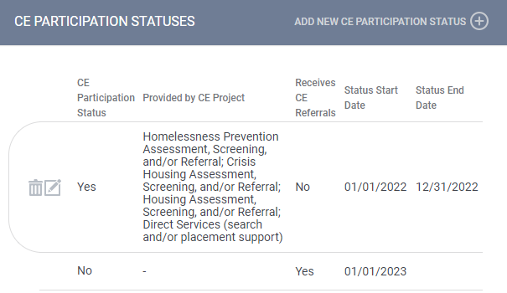
Program Setup Updates
CE Participation Status
  Now required to select what role every project plays as it relates to Coordinated Entry – either Access Point (what services?) or Receives Referrals

Slide 9
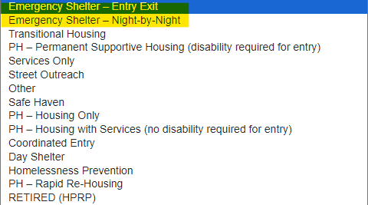
Program Setup Updates
Emergency Shelter – Night-by-Night vs. Entry/Exit
  This has always been tracked. Different method of tracking now.

Slide 10
Program Setup Updates
Rapid Rehousing – Services only vs. Housing with or without services
  RRH projects now require a subtype to be selected.
  All RRH projects will be mapped to “Housing with or without services”
  Shelter projects that are providing RRH case management will now be required to enter those clients into separate project in HMIS. These projects will be available on 10/1.
    Salvation Army – PASS
    Salvation Army – Zelma George
    Family Promise
    West Side Catholic Center (repurpose current SSO project)

Slide 11

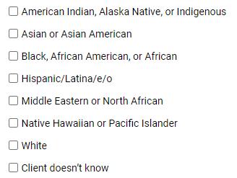
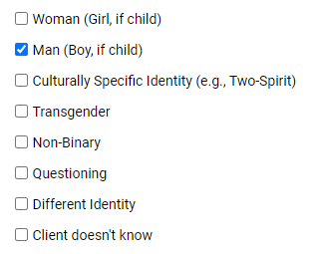


Profile Screen Updates
Race and Ethnicity
  Combined into one element and added options
Gender
  Updated language and options
Race and Ethnicity will be mapped based on previous responses. Double check all information
Gender will not be mapped.
Double check all data on these screens!
  Textbox available for additional race/ethnicity detail

Slide 12

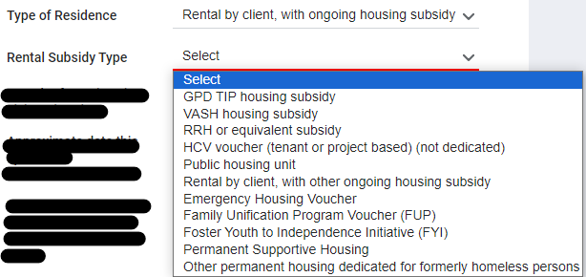
Enrollment Screen Updates
Prior Living Situation
  Added dependent fields if “Rental by client, with ongoing housing subsidy” selected.
  Crosswalk has been created to dictate which rental subsidy type should be picked.

Slide 13
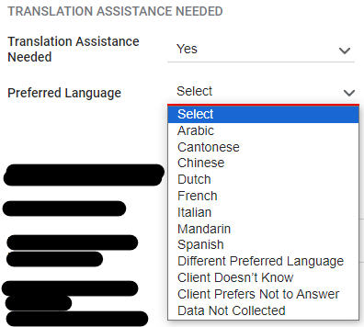
Enrollment Screen Updates
Translation Assistance Needed
  Required for all CoC, ESG, and HOPWA projects.
  Picklist is set at local level. Can add/remove languages based on need. List should be limited to 10-15 languages.
  If “Different Preferred Language” is selected, textbox will appear.

Slide 14
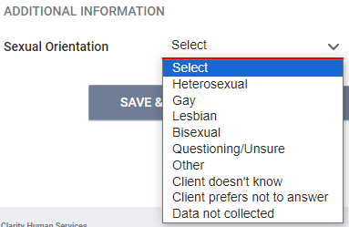
Enrollment Screen Updates
Sexual Orientation
  Locally required for ALL projects!
  Required for RHY projects prior to these changes.
  Now required by HUD for all CoC PSH projects!
  If entered on PROFILE screen (local requirement), data will cascade to enrollment screen.
Well-being
  RETIRED from all projects
  Data collection can stop on 9/30/2023.

Slide 15
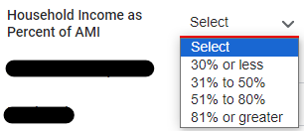
Enrollment Screen Updates
SSVF ONLY
Percent of AMI
  Updated picklist options
Last Permanent Address
  RETIRED
HP Targeting Criteria
  4 questions reworded slightly
HP Targeting Criteria Changes:
C – Past experience of homelessness (street/shelter/TH) (any adult)
D – Head of Household is not a current leaseholder/renter of a unit
E – Head of Household has never been a leaseholder/renter of a unit
N – Single parent/guardian household with minor child(ren)

Slide 16

Status and Current Living Situation Screen Updates
BCP Status RETIRED
RHY ONLY
Well-being RETIRED
Current Living Situation updated
Options are updated the same as Prior Living Situation

Slide 17

Federal Partner Service Updates
SSVF
  “Extended Shallow Subsidy – Rental Assistance” updated to “Shallow Subsidy – Financial Assistance”
  NEW Landlord Incentive
  NEW Tenant Incentive
  SERVICE DATES change
    Single Event – one date entered
    Long-term Event – date range entered

Slide 18
Federal Partner Service Updates
HOPWA
  “Substance use disorder services/treatment” updated to “Substance use services/treatment”
RHY
  “Post-natal care for mother” updated to “Post-natal care for client (person who gave birth)”

Slide 19

Coordinated Entry Event Updates
Originally, HUD had planned to make several changes to how CE Events were captured. They have backed away from those changes and everything remains the same except…
  “Referral to Emergency Housing Voucher” is being removed as a possible event.
  If this still needs to be selected, choose “Referral to Other PH project/unit/resource opening”.

Slide 20

Exit Screen Updates
BCP Status RETIRED
Well-being RETIRED
Destination updated
Options are updated the same as Prior Living Situation & Current Living Situation

Slide 21

What do you need to do?
NOW:
  Update all internal agency paperwork used to capture these data elements to reflect the data standard changes.
ON 10/1:
  For all active clients on 10/1:
    Review PROFILE screens for correct Race/Ethnicity & Gender information.
    Review ENROLLMENT screens and enter all data that may be missing.
      Translation Assistance (CoC, ESG, HOPWA)
      Sexual Orientation (CoC PSH)
  RRH Shelter providers:
    Enroll all clients receiving RRH case management in new RRH Services Only projects.
MOVING FORWARD:
  Collect and enter all data

Slide 22

Links to Resources
HUD Exchange – Data Standards
  https://files.hudexchange.info/resources/documents/HMIS-Data-Standards-Manual-2024.pdf
HUD Exchange – Data Dictionary
  https://files.hudexchange.info/resources/documents/HMIS-Data-Dictionary-2024.pdf
All Bitfocus 2024 Data Standard Resources (2024 ONLY)
  https://www.bitfocus.com/services/data-and-reporting

Slide 23

QUESTIONS

