Slide 1

HMIS By-Name List Refresher Training
Cleveland/Cuyahoga County Office of Homeless Services
Notes:
Nick

Slide 2


Housekeeping
This webinar will be recorded and made available on OHS’s website as soon as possible.
You will be muted and cameras will be off for the duration of the webinar.
If you have a question:
Put your question in the Q&A – someone will respond
Information shared in this webinar should be disseminated to all HMIS end users and interested parties!
Hold the question until the live Q&A at the end of the session
Notes:
Nick

Slide 3

Agenda
By-Name List Activation
By-Name List Assessment
Housing Offer Assessments
Housing Offer Forms
By-Name List Inactivation
By-Name List Reactivation
Friday’s Housing Meetings
Live Q&A
Notes:
Nick

Slide 4

By-Name List Activation
Notes:
Amanda

Slide 5

Participants to Activate
Homeless individuals or heads of households being served by a program or outreach provider.
Should have an identified housing plan using CoC or other funding
The following subpopulations should be activated regardless of housing plans:
  Unsheltered persons & families
  Homeless veterans or veteran-led families
  Homeless young adults and young adult-led families
  Homeless families
  Chronically homeless persons & families
Notes:
Need signed consent to activate

Slide 6
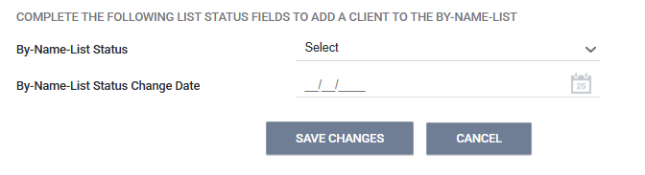
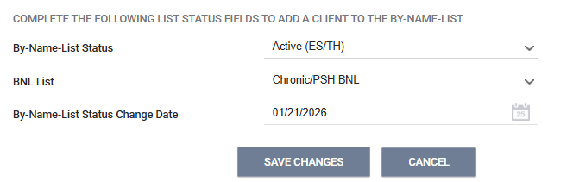
HMIS Data Entry Process
  By-Name-List Status:
    Active (ES/TH) = active and currently in a shelter or transitional housing program.
    Active (unsheltered) = active and currently in a place not meant for human habitation.
  By-Name-List Status Change Date
    Date on which the list status and information was collected or changed. If unknown, enter today’s date. If inactivating due to no contact for 90+ days, back date this date to the 90th day of no contact.
Notes:
If participant is not a member of any subpopulations listed, do not select any of the options.

Slide 7

By-Name List Assessment
Notes:
Amanda

Slide 8
BNL Assessments
1 period of homeless = 1 BNL Assessment
If you just activated someone on the BNL, most of the time, they would need a new BNL Assessment.
  It is always good practice to check the Assessment History to ensure a BNL Assessment hasn’t already been started for this period of homelessness
Some elements from the BNL cascade from/to other assessments so be sure that the information you are changing is accurate.
Assessment Date – date assessment was completed in HMIS
Date Identified – date of initial contact with a person experiencing homelessness in any program or at any other point of homeless entry.
Verified Chronic – Only CE can verify chronicity. For those that are presumed chronic, select “Presumed Chronic”
Notes:
A new program enrollment does not necessarily mean a new BNL Assessment
The whole assessment doesn’t need to be completed in it’s entirety, but note that any information that is not completed could affect someone’s opportunity to be slotted

Slide 9
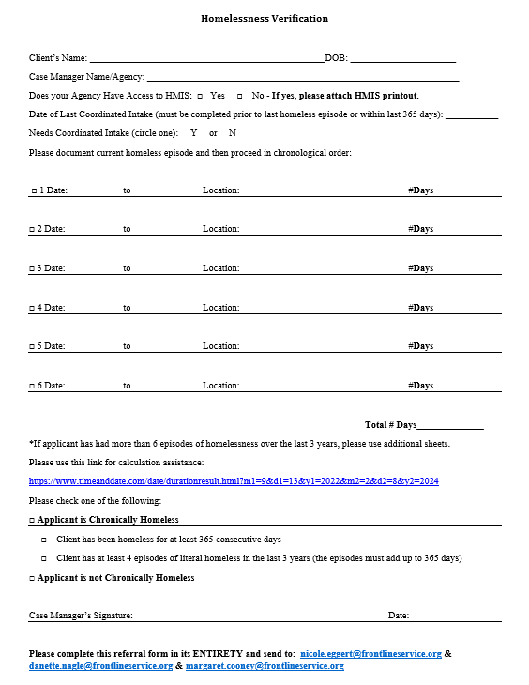
To Verify Chronicity:
Ensure that the Chronic/PSH BNL is selected on Profile Screen
Select “Presumed Chronic”
Complete Homeless Verification Form with unsheltered/non-HMIS homeless time
Upload the Homeless Verification Form to HMIS
Send an email to CE notifying them that the above form is in HMIS
  CE ONLY changes BNL Assessment = “Verified Chronic” & adds days
Notes:
Amanda

Slide 10

HMIS Data Entry Process
Notes:
Amanda

Slide 11
Housing Offer Assessments
Notes:
Amanda

Slide 12
Housing Offer Assessments
When a participant is slotted for an opportunity, 99.9% of the time, CE will start a Housing Offer Assessment with the following data elements:
  Assessment Date
  Type of Housing Offered
  Building Offered (if applicable)
  Offer Notes
After the Slotted Participant Spreadsheet is released by CE, Case Management Providers need to go in and complete the following:
  Date of Housing Offer
  Offer Outcome & Date
  Document Ready for Housing Offer
  Application Submitted for Housing Offer & Date
Housing Providers:
  Application Submitted for Housing Offer & Date
  Offer Interview Completed & Date
  Housing Inspection Completed & Date
NOTES can be entered by anyone for any reason!
  PLEASE, never delete any notes. Just create a new line with the date
    Example:
1/20/2026 – slotted for CoC Lotus
1/22/2026 – Signed HOF uploaded
Notes:
Always be sure to check that the Housing Offer Assessment is under Assessment History that matches the date the participant was slotted for. If one is not in there, you can create one.

Slide 13

Accepting and Denying Offers
Accepted Offer:
  Move on to Housing Application and required document gathering
Denied Offer:
  Participant will maintain spot on list until they deny 3 consecutive, viable offers
  Drop to the bottom of prioritization
  Not eligible for another opportunity for 6 months.
  Housing providers rejecting the participant or missed application deadlines do not count as denied offers.
Notes:
Amanda

Slide 14
HMIS Data Entry Process
Notes:
Amanda

Slide 15

Housing Offer Forms
Notes:
Nick

Slide 16

When is a Housing Offer Form Needed?
Accepted Offers
  Housing Offer Assessment Offer Outcome = Accepted
Denied Offers:
  Housing Offer Assessment Offer Outcome = Denied – Client Rejected
  You do NOT need a signed Housing Offer Form uploaded if the Offer Outcome =
    Denied – Provider Rejected
    Denied – Application Deadline Missed
    Missing/Left Shelter
Notes:
Nick

Slide 17
Completing HOF
Participant Name
Agency Offering Housing
Staff Name Offering Housing
Type of Housing Offered
Name of PSH Building Offered (if applicable)
Whether the participant has accepted or denied
  Select the reasoning for declining
Staff Signature
Participant Signature
  If a participant refuses to sign, please note that on the Participant Signature line
    This should be minimal and every effort to obtain a participant signature should be attempted
The information on the Housing Offer Form should match the data on the Housing Offer Assessment.
  This is important to compare which Housing Offer Form matches the corresponding Housing Offer Assessment especially when participants are offered multiple housing opportunities
Once completed, should be uploaded under the FILES tab of a participant’s record
Notes:
Nick

Slide 18

Uploading HOFs
Click FILES at the top of the screen within a participant’s record.
Click ADD FILE
Select FILE CATEGORY “Housing Documentation”
Select Predefined Name as “Housing Offer Form”
Upload the file as normal.
Notes:
Nick

Slide 19
HMIS Data Entry Process
Notes:
Amanda

Slide 20

By-Name List Inactivation
Notes:
Amanda

Slide 21

When to Inactivate?
Once a participant has been either permanently housed or non-permanently housed
  BNL Status Change Date should be as of Housing Move In Date
If a person has been missing/no contact made for 90 days
  If inactivating due to no contact for 90+ days, back date the By-Name-List Status Change Date to the 90th day of no contact.
  If someone discharges from your project to either a hospital or jail but is re-enrolled back into your project after 30 days, this does not mean they are entering a new period of homelessness, and can remain active on the list
    If the participant is in the hospital/jail for 90 days or longer. Deactivate them from the list.
Notes:
Amanda

Slide 22
HMIS Data Entry Process
Search for the participant using any information available to you (e.g., name, HMIS ID, date of birth, etc.)
On the PROFILE screen, select the correct inactive BY-NAME-LIST STATUS.
For BNL LIST, there is no need to unselect any options.
Enter the date the BNL status changed next to BY-NAME-LIST STATUS CHANGE DATE
  NOTE: If a participant goes missing for 90 days and is inactivated for that reason, the date entered for BY-NAME-LIST STATUS CHANGE DATE should be the 90th day missing – not the date the status is changed within Clarity.
Click SAVE CHANGES.
Notes:
Amanda

Slide 23

By-Name List Reactivation
Notes:
Amanda

Slide 24

BNL Reactivation
If a participant who was missing reengages and seeks CoC housing resources
If a participant was removed from the BNL due to being housed, but ultimately loses their housing and return to homelessness
Once a participant is re-identified as one of the subpopulations listed below, the Participating Agency should then re-activate on the BNL
  Unsheltered persons & families
  Homeless veterans or veteran-led families
  Homeless young adults and young adult-led families
  Homeless families
  Chronically homeless persons & families
Notes:
Amanda

Slide 25

Friday Housing Meetings
Notes:
Nick

Slide 26

Friday Housing Meetings
  Review/Update Housing Plans
    If CE asks for something to be updated on the BNL, you should NOT create a new one.
    Under the Assessment tab, scroll down to ASSESSMENT HISTORY and edit the current BNL in the system
  Update on slotted participant’s application process and status
    Review timeframes and deadlines
  Review BNL to identified participant’s that are close to reaching 90 days of no updates.
  Case Conferencing
Notes:
Nick

Slide 27

Questions?

