Slide 1

HMIS By-Name List and Slotting Processes
Cleveland/Cuyahoga County Office of Homeless Services
Notes:
Nick

Slide 2


Housekeeping
This webinar will be recorded and made available on OHS’s website as soon as possible.
You will be muted and cameras will be off for the duration of the webinar.
If you have a question:
Put your question in the Q&A – someone will respond
Information shared in this webinar should be disseminated to all HMIS end users and interested parties!
Hold the question until the live Q&A at the end of the session
Notes:
Nick

Slide 3

Agenda
By-Name List Overview
By-Name List Assessment
Verification of Chronic Homelessness
Vulnerability Index
Housing Offer Forms/Assessments
Live Q&A
Slotting Processes
Permanent Supportive Housing Applications
By-Name List Inactivation
By-Name List Reactivation
By-Name List Report in HMIS
By-Name List Activation
Friday’s Housing Meetings
Notes:
Nick

Slide 4

By-Name List Overview
Notes:
Nick

Slide 5
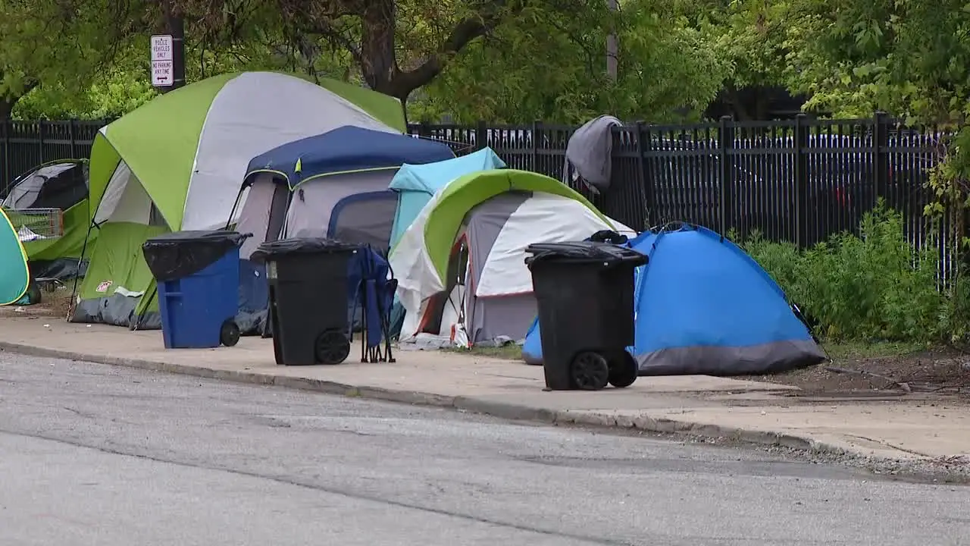
By-Name List Overview
A comprehensive, real-time list of names of those experiencing homelessness in our community.
Track and manage the homeless population by individual rather than aggregately.
  Includes details on housing needs, health status, and homeless history.
Enables targeted interventions and progress monitoring toward ending homelessness.
Fox 8 News
Notes:
Nick

Slide 6

By-Name List Activation
Notes:
Amanda

Slide 7

Participants to Activate
Homeless individuals or heads of households being served by a program or outreach provider.
Should have an identified housing plan using CoC or other funding
The following subpopulations should be activated regardless of housing plans:
  Unsheltered persons & families
  Homeless veterans or veteran-led families
  Homeless young adults and young adult-led families
  Homeless families
  Chronically homeless persons & families
Notes:
Amanda

Slide 8

Consent To Activate
Verbal or written consent is required to enter persons into HMIS with personally identifiable information present.
Consent refused = anonymous records
  No identifiable information
  Unique identifier applied
  All pertinent by-name list information can be added
It is the responsibility of the agency adding the anonymous record to keep track of who each record belongs to.
Notes:
Amanda

Slide 9

Responsible Parties
CE Access Point:
  Activate only those identified as a special subpopulation and are NOT diverted.
Provider Agencies:
  Activate those identified as a special subpopulation AND/OR
  Those who proceed through the housing assessment portion of the CE intake (i.e., those identified as needing CoC resources for housing)
Non-HMIS-Participating Providers:
  Send referrals to list to CE
Notes:
Nick

Slide 10
HMIS Data Entry Process
Search for the participant using any information available
  Create new record if participant does not already exist
On the PROFILE screen, select the cored BY-NAME-LIST STATUS.
  Active (ES/TH) = active and currently in a shelter or transitional housing program.
  Active (unsheltered) = active and currently in a place not meant for human habitation.
Select the correct subpopulation list for BNL LIST.
  If participant is not a member of any subpopulations listed, do not select any of the options.
Enter the date the BNL status changed for BY-NAME-LIST STATUS CHANGE DATE.
Click SAVE CHANGES.
Notes:
Nick

Slide 11

By-Name List Assessment
Notes:
Amanda

Slide 12

BNL Assessments
Primary source of information about active participants
BNL assessments do not have to be completed all at once but should be initiated at time of activation.
Some elements from the BNL cascade to other assessments so be sure that the information you are changing is accurate.
Notes:
Amanda

Slide 13

Responsible Parties
Provider Agencies
  Primary agency working with participant should be compiling and updating information
Non-Participating Agencies
  Send hard copy version of BNL Assessment to CE to complete in HMIS
ULTIMATELY – it is the responsibility of all providers working with a participant to update and complete BNL Assessments!
Notes:
Amanda

Slide 14
HMIS Data Entry Process
Click ASSESSMENTS at the top of the screen within a participant’s record.
Click START on the BNL ASSESSMENT row.
Complete the assessment with the information available.
  Data definitions for each of the data elements on the BNL Assessment are in Appendix D of the Cleveland/Cuyahoga CoC By-Name List (BNL) Procedure document.
Click SAVE.
Notes:
Amanda

Slide 15

Verification of Chronic Homelessness
Notes:
Nick

Slide 16
Chronic Homelessness
A homeless individual with a disability as defined in section 401(9) of the McKinney-Vento Assistance Act, who:
  Lives in a place not meant for human habitation, safe haven, or in an emergency shelter, and
  Has been homeless for at least 12 months or at least 4 separate occasions in the past 3 years, as long as the occasions equal at least 12 months and each break in homelessness separating the occasions included at least 7 consecutive nights of not living as described above.
An individual who has been residing in an institutional care facility, including jail, substance abuse or mental health treatment facility, hospital, or other similar facility, for fewer than 90 days and met all the criteria of this definition before entering that facility, or
A family with an adult head of household who meets all of the criteria of this definition.
Notes:
Nick

Slide 17
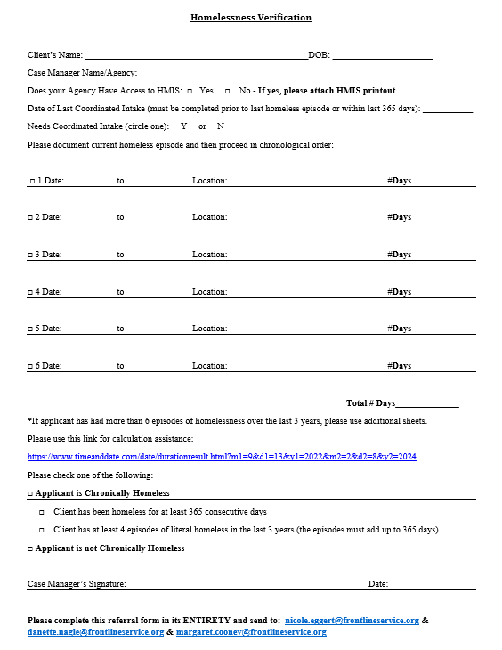
Process to Verify CH
BNL Assessment = “Presumed Chronic”
Homeless Verification Form
Upload form in HMIS record
Notify CE via email
CE reviews and approves
CE ONLY changes BNL Assessment = “Verified Chronic” & adds days
Non-HMIS providers: complete and send to CE for uploading.
Notes:
Nick

Slide 18

Vulnerability Index
Notes:
Amanda

Slide 19

Vulnerability Index Assessment
Is a primary determinant of who gets selected for different housing resources
The VI will be used to select the most vulnerable participants regardless of the length of time homeless.
Tracked in HMIS and pulled into the BNL to prioritize for slotting.
Non-HMIS providers: complete and send to CI for uploading
Notes:
Amanda

Slide 20
HMIS Data Entry Process
Click ASSESSMENTS at the top of the screen within a participant’s record.
Click START on the CUYAHOGA VULNERABILITY INDEX row.
Complete the assessment with the information available.
Click SAVE.
Notes:
Amanda

Slide 21

Slotting Processes
Notes:
Nick

Slide 22
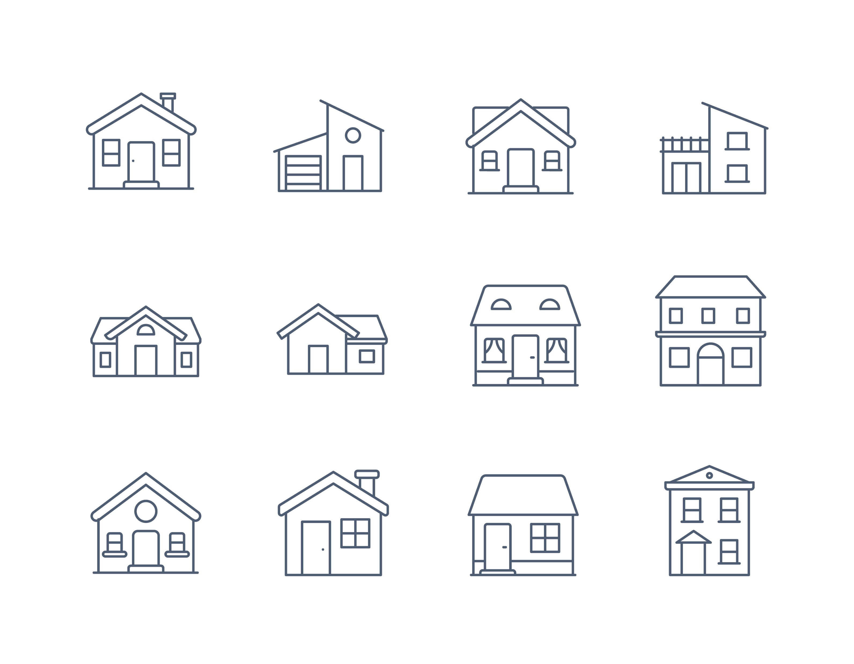
Identifying Available Housing Resources
Every Monday, housing providers will send an email to Coordinated Intake (& OHS) identifying available vouchers and move-in ready units – RRH & PSH
  Site/building name
  Address
  Unit number
  Bedroom count
  Subsidy source
  ADA-accessibility information
  Eligibility criteria
  Project-specific service design/partners
Notes:
Nick

Slide 23
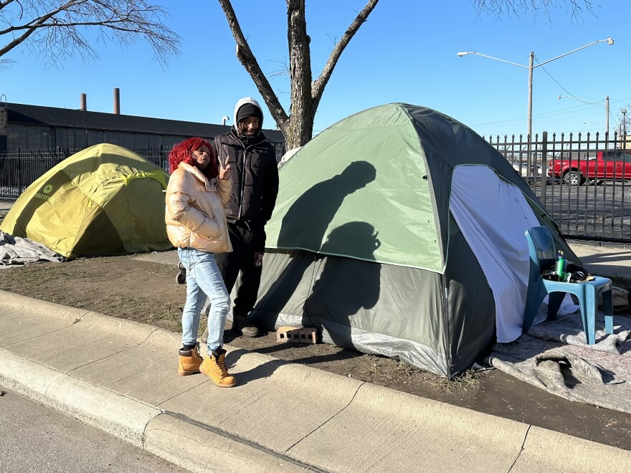
Prioritization Criteria
Vulnerability Index score
Chronically homeless
Long-term homeless and disabled
Long-term homeless and not disabled
Short-term homeless and disabled
Short-term homeless and not disabled
Participant choice & system management needs could create prioritization exceptions!
Stephanie Czekalinski / Ideastream Public Media
Notes:
Nick

Slide 24

RRH to PSH Transfers*
*Policy is pending OHS Advisory Board approval
During a calendar month, between one and up to 10% of all available PSH slots will be designated for transfers from RRH to PSH.
Requires at least 6 months of RRH enrollment to be considered.
Prioritized based on the score of the RRH to PSH Transfer Housing Stability Assessment.
Chronic homelessness needs to be documented where necessary
Notes:
Nick

Slide 25
RRH to PSH Transfer
Housing Stability Assessment*
*Assessment is pending OHS Advisory Board approval
Category | Indicator | Score | Notes
Homeless History | Participant has an HMIS record of previous shelter stays or outreach contacts. | 6
Lease Violation | Participant has been asked to vacate unit by landlord or property manager. | 2
Age | Participant is 28 or younger | 1
 | Participant is aged 29-54 | 0
 | Participant is 55 or older | 1
Financial | Participant’s monthly gross income is less than 50% of the FMR for a 1-bed unit [~$500 in 2025] | 1
Linkages | Participant is not connected to resources necessary to sustain housing such as employment services, drug treatment, mental health treatment, etc. | 1
 | Family and/or social supports are not available or unable to assist with ongoing or future crises. | 1
Housing Plan | Participant has not demonstrated engaged, measurable progress toward housing stability plan goals. | 1
Total Score
Notes:
Nick

Slide 26
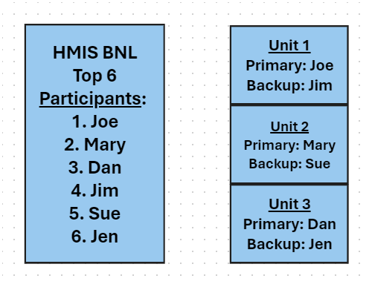
Slotting
BNL in HMIS will be sorted based on:
  Verified Chronic?
  VI Score
  Total LOT Homeless (unsheltered + HMIS)
Each available RRH or PSH voucher will have a primary & backup slotted.
Selected participants’ case managers will be notified by end of day Tuesdays.
Notes:
Nick

Slide 27
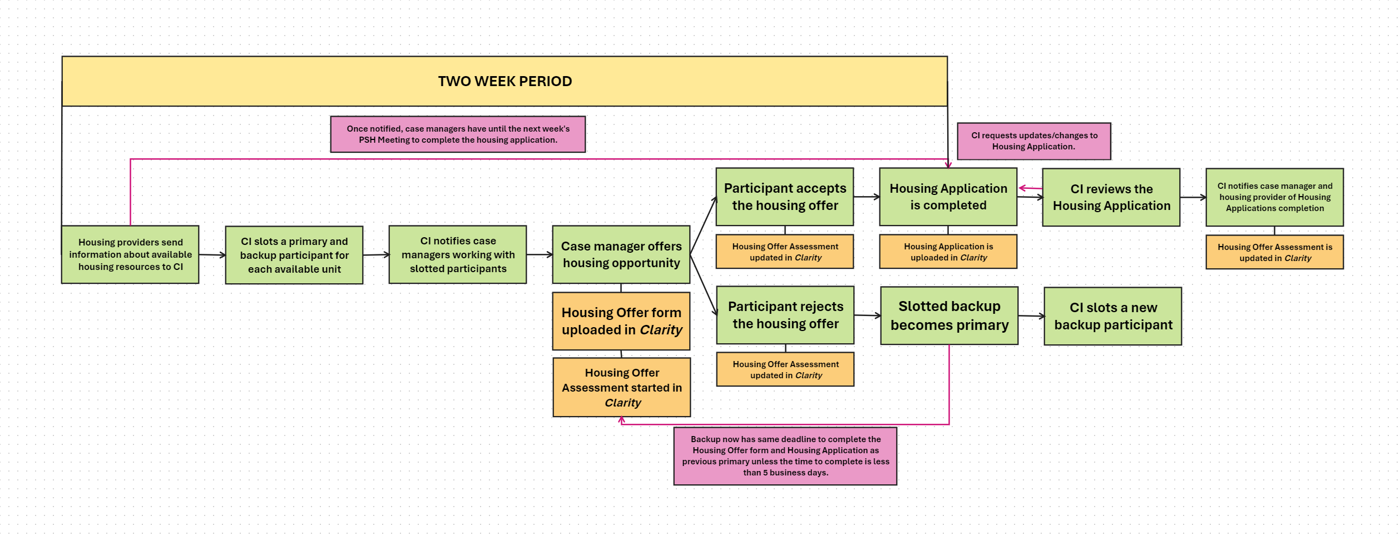
Timeframes and Deadlines
Notes:
Nick

Slide 28
Housing Offer Forms & Assessments
Notes:
Amanda

Slide 29

Housing Offer Forms & Assessments
Documented on a Housing Offer Form and Housing Offer Assessment
  Housing Offer Form – signed by participant and worker - uploaded into HMIS under FILES
  Housing Offer Assessment – located under the ASSESSMENTS tab in HMIS
Non-HMIS participant providers:
  Housing Offer Forms to CI for uploading
  Housing Offer Assessment completed by CI
Notes:
Amanda

Slide 30

Accepting and Denying Offers
Accepted Offer:
  Move on to Housing Application and required document gathering
Denied Offer:
  Participant will maintain spot on list until they deny 3 consecutive, viable offers
  Drop to the bottom of prioritization
  Not eligible for another opportunity for 6 months.
  Housing providers rejecting the participant or missed application deadlines do not count as denied offers.
Notes:
Amanda

Slide 31
Responsible Parties
For Primarily Slotted Participants:
Coordinated Intake:
  Creates Housing Offer Assessment
  Add:
    Type of Housing Offered
    Building Offered (if applicable)
Case Management Providers:
  Add:
    Date of Housing Offer
    Offer Outcome & Date
    Document Ready for Housing Offer
    Application Submitted for Housing Offer & Date
Housing Providers:
  Add:
    Application Submitted for Housing Offer & Date
    Offer Interview Completed & Date
    Housing Inspection Completed & Date
NOTES can be entered by anyone for any reason!
Notes:
Amanda

Slide 32
Responsible Parties
For Backup Participants after Primary denies/rejects:
Coordinated Intake:
  NONE!
Case Management Providers:
  Creates Housing Offer Assessment
  Add:
    Date of Housing Offer
    Type of Housing Offered
    Building Offered (if applicable)
    Offer Outcome & Date
    Document Ready for Housing Offer
    Application Submitted for Housing Offer & Date
Housing Providers:
  Add:
    Application Submitted for Housing Offer & Date
    Offer Interview Completed & Date
    Housing Inspection Completed & Date
NOTES can be entered by anyone for any reason!
Notes:
Amanda

Slide 33
HMIS Data Entry Process
Click ASSESSMENTS at the top of the screen within a participant’s record.
If one has already been started, click on the edit icon to left. If one has not been started, click START on the Housing Offer Assessment row.
Complete the assessment based on previous outline roles.
Notes:
Amanda

Slide 34

Permanent Supportive Housing Applications
Notes:
Nick

Slide 35

PSH Application Review Process
Case manager completes application and gathers documents.
Case manager uploads applications and documents into FILES section of HMIS record.
Notify CE via email once uploaded.
Review by CE and back-and-forth w/ case manager getting fixes applied.
CE will complete CMHA preference letters for those slotted for CMHA units.
CE notifies housing provider via email.
Non-HMIS providers: send applications directly to CE via email
Notes:
Nick

Slide 36

PSH Application Timelines
PSH applications must bed dated within 120 days of approval.
Homeless letters, disability verification, SS award letters, etc. must be dated within 120 days of approval.
Pay stubs, food stamp letters, statements of no income, or any other documentation of fluctuating income must be dated within 30 days of approval.
Notes:
Nick

Slide 37
HMIS Data Entry Process
Click FILES at the top of the screen within a participant’s record.
Select FILE CATEGORY “Housing Documentation” and then “Housing Application”.
Upload the file as normal.
Notes:
Nick

Slide 38

COMING SOON: Universal Supportive Housing Application (USHAP)
Right now, separate apps exist for different subsidies.
In Q2, universal application for all subsidies will be completed in HMIS!
Supporting docs will still need uploaded in FILES.
Next steps: create reporting to have it come out of the system as an app and not as raw data.
Notes:
Nick

Slide 39

By-Name List Inactivation
Notes:
Amanda

Slide 40


When to Inactivate?
Once a participant has been either permanently housed or non-permanently housed
  Responsibility of the HMIS participating housing provider to inactivate
  CI inactivates participants from non-HMIS participating providers
If a person has been missing/no contact made for 90 days, it is also the HMIS participating housing provider to inactivate the participant
Notes:
Amanda

Slide 41
HMIS Data Entry Process
Search for the participant using any information available to you (e.g., name, HMIS ID, date of birth, etc.)
On the PROFILE screen, select the correct inactive BY-NAME-LIST STATUS.
For BNL LIST, there is no need to unselect any options.
Enter the date the BNL status changed next to BY-NAME-LIST STATUS CHANGE DATE
  NOTE: If a participant goes missing for 90 days and is inactivated for that reason, the date entered for BY-NAME-LIST STATUS CHANGE DATE should be the 90th day missing – not the date the status is changed within Clarity.
Click SAVE CHANGES.
Notes:
Amanda

Slide 42

By-Name List Reactivation
Notes:
Amanda

Slide 43

BNL Reactivation
If a participant who was missing reengages and seeks CoC housing resources
If a participant was removed from the BNL due to being housed, but ultimately loses their housing and return to homelessness
Once a participant is re-identified as one of the subpopulations listed below, the Participating Agency should then re-activate on the BNL
  Unsheltered persons & families
  Homeless veterans or veteran-led families
  Homeless young adults and young adult-led families
  Homeless families
  Chronically homeless persons & families
Notes:
Amanda

Slide 44

Friday Housing Meetings
Notes:
Nick

Slide 45

Friday Housing Meetings
  Review/Update Housing Plans
  Update on slotted participant’s application process and status
    Review timeframes and deadlines
  Review BNL to identified participant’s that are close to reaching 90 days of no updates.
  Case Conferencing
Notes:
Nick

Slide 46

By-Name List Report in HMIS
Notes:
Nick

Slide 47

By-Name List Report
Users with Agency Administrator – Systemwide Data Analysis or Outreach Manager/Agency Admin – Systemwide Data Analysis access roles can run the report and see the full dataset across the CoC
Those with Agency Administrator or Outreach Manager/Agency Admin access roles can run the report, but only see their agency’s data
All Participating Agencies are responsible for knowing which agency users have access to run the report.
Those users should run the report regularly and distribute it to other staff in their agency to review
Notes:
Nick

Slide 48
By-Name-List Report Process in HMIS
Click the MENU icon in the top right corner of the screen
Click REPORTS
Click DATA ANALYSIS at the top of the screen
Click CUYAHOGA CLARITY SYSTEM REPORTS for a drop down
Click RUN on the CUYAHOGA BNL row
The report can be filtered by subpopulation using the BNL List data element on the PROFILE screen. It can also be sorted by any of the column headers.
Notes:
Nick

Slide 49

Questions?

